Slide 1
Computer vision and deep learning
Lecture 1

Slide 2
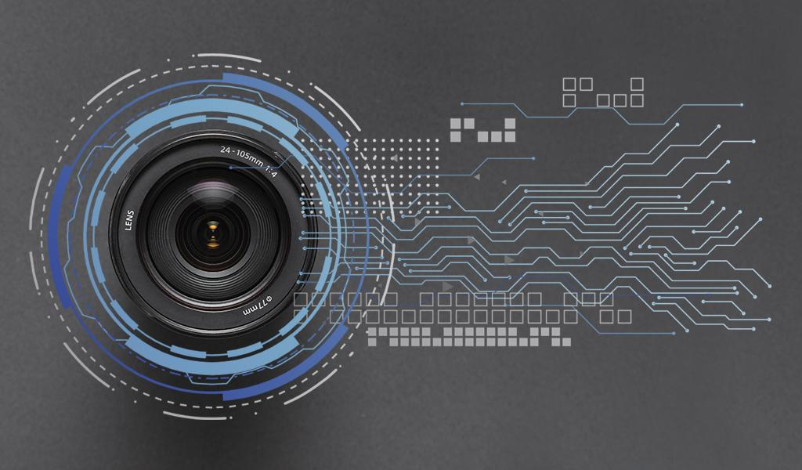
What is Computer Vision (CV)?
Goal: build computer-based vision systems which perform the same functions as the human visual system
CV builds the theoretical and algorithmic basis by which useful information about the world can be extracted and analysed from an image, a set of images (e.g. stereo vision) or an image sequence

Slide 3
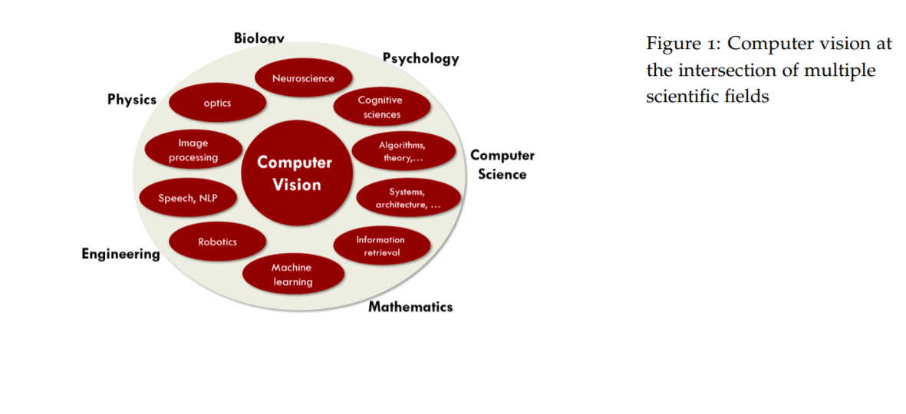
Computer vision – multidisciplinary subject
http://vision.stanford.edu/teaching/cs131_fall1718/files/cs131-class-notes.pdf

Slide 4
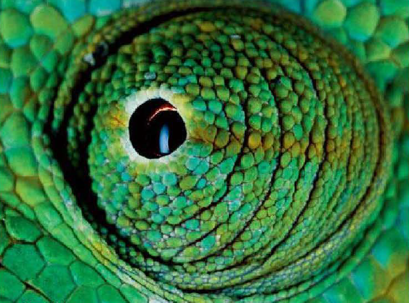
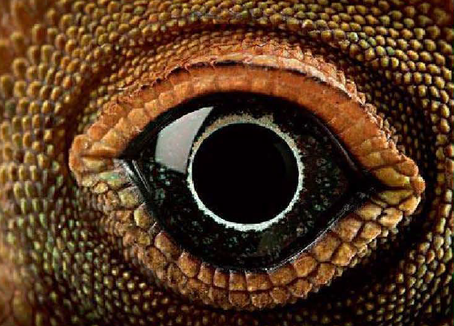
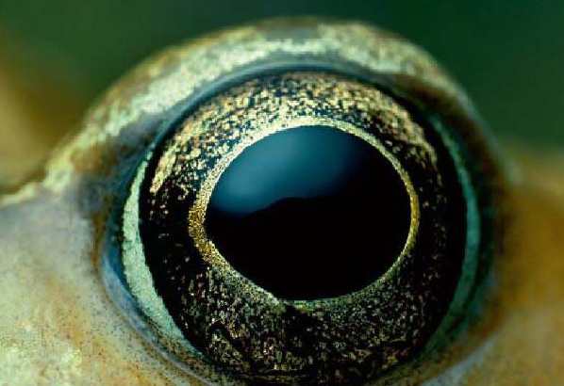
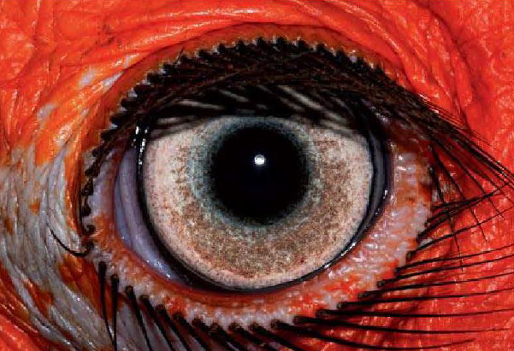
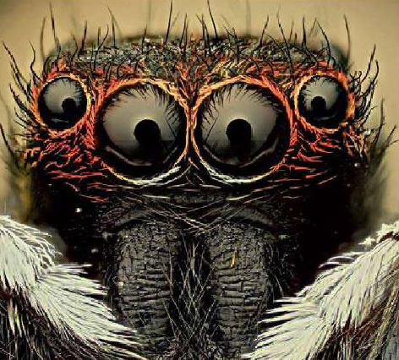
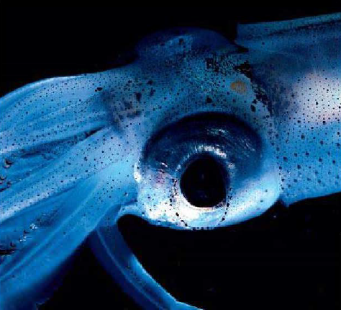
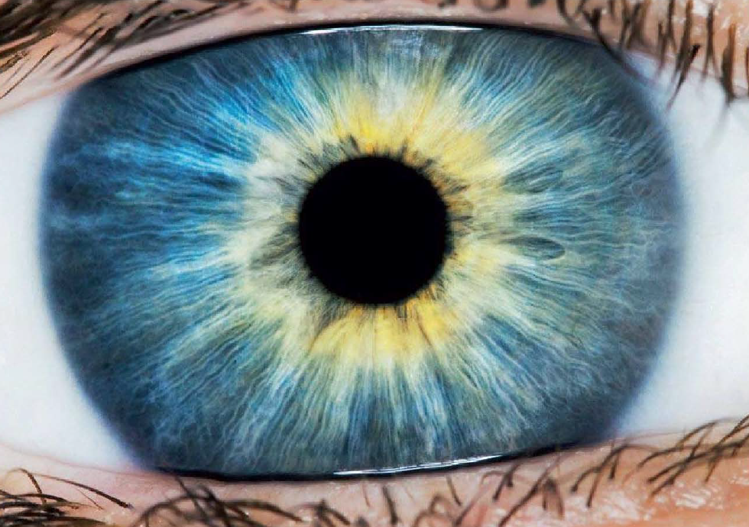
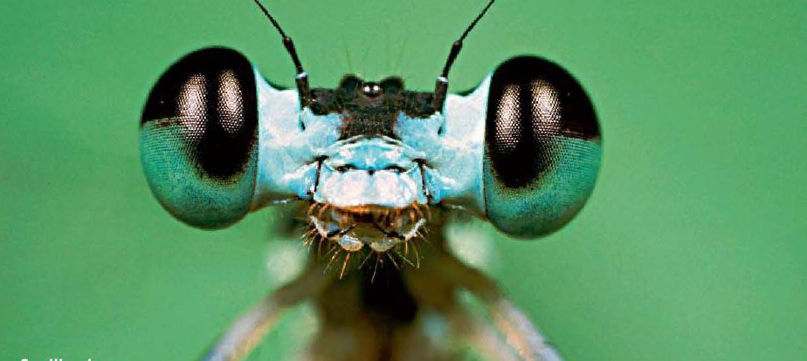
Image source: Le miracle de la vision, Christian Schwagerl, Rainer Harf et Henning Engeln

Slide 5
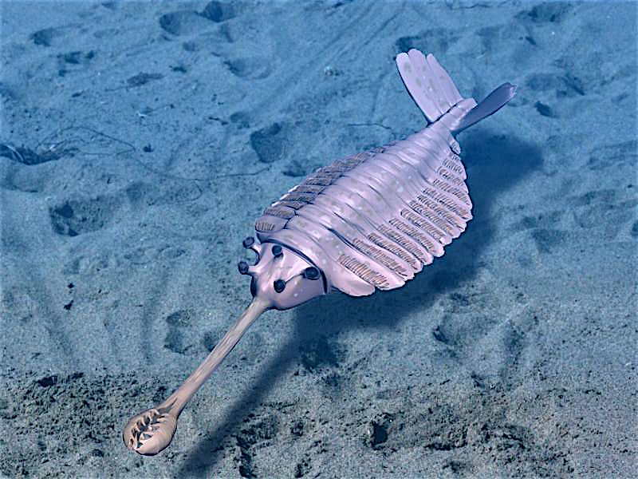
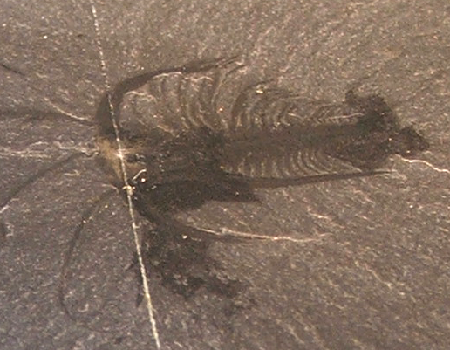
Evolution of the eye
Cambrian Explosion: 541 million years ago
Image source: https://en.wikipedia.org/wiki/Cambrian_explosion

Slide 6
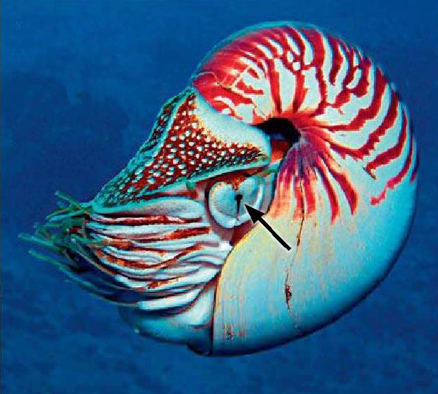
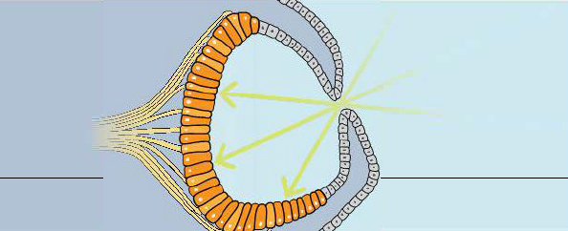
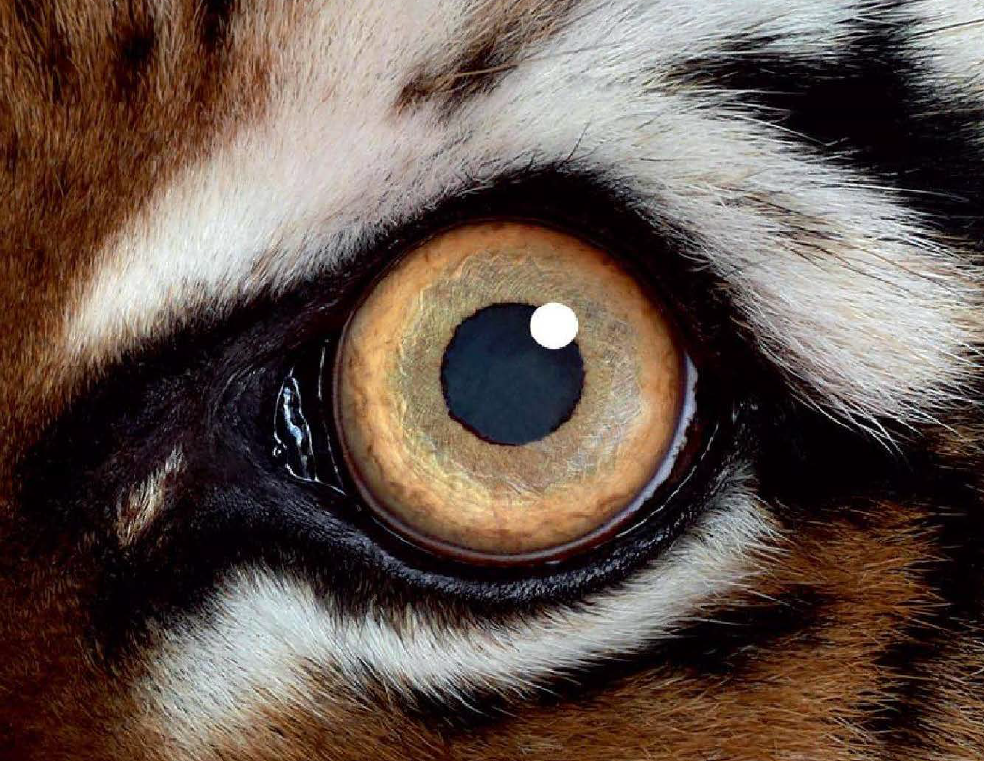
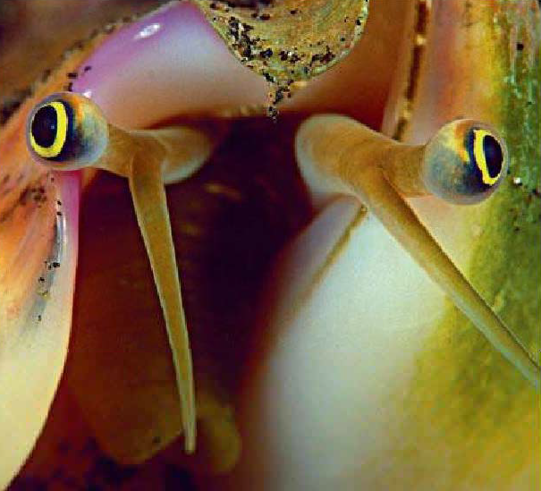
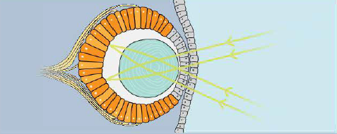
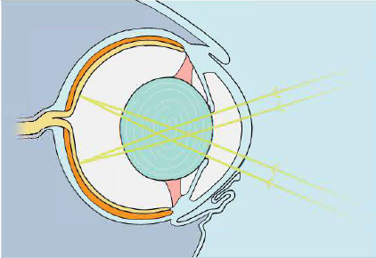
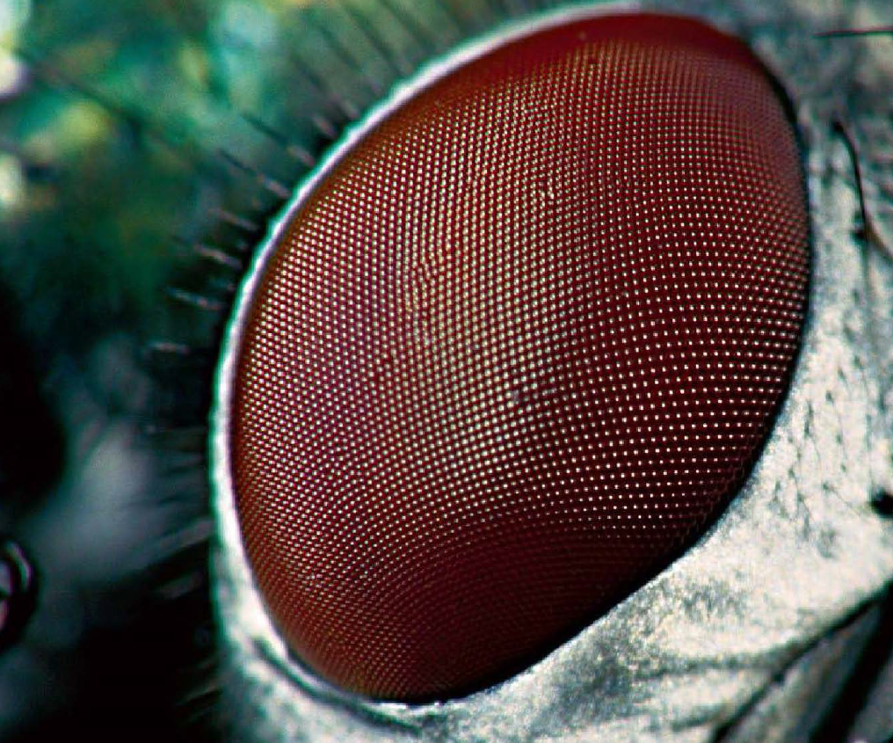
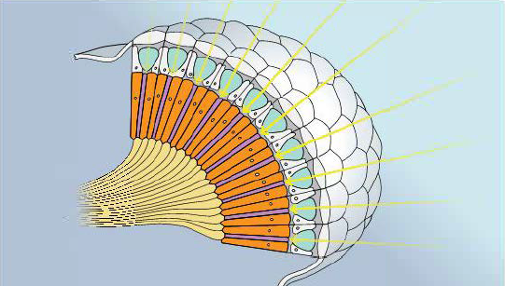

Slide 7
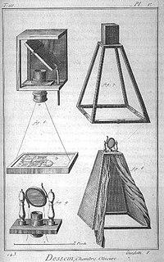
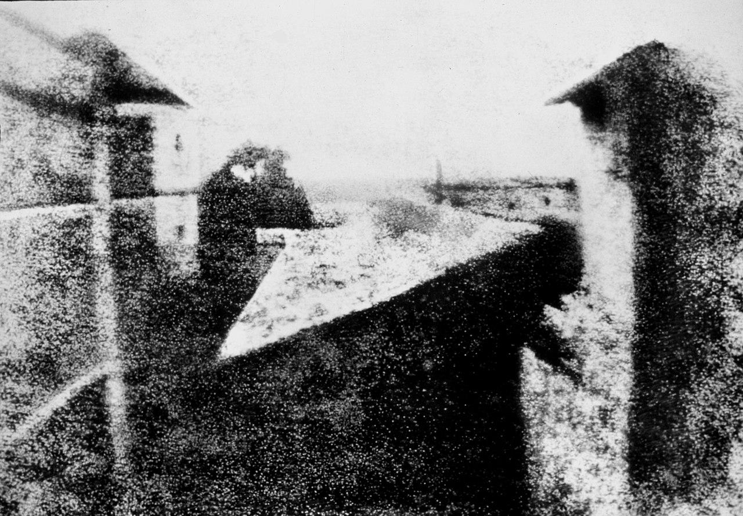
History of the camera
Chinese philosopher Mozi (470 – 391 BC) first person in history to describe the first to describe the physical principle behind the camera
Alhazen (Ibn al-Haytham) (965–1040 AD) – considered the inventor of the pinhole camera
First permanent photograph (1825) by Joseph Nicéphore Niépce (8h exposure time)
18th century description of a pinhole camera
Encyclopedia
View from the Window at Le Gras, 1827
Oldest surviving camera photograph

Slide 8
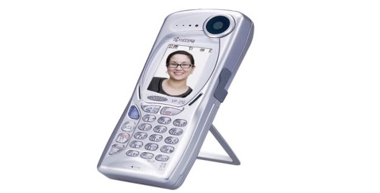
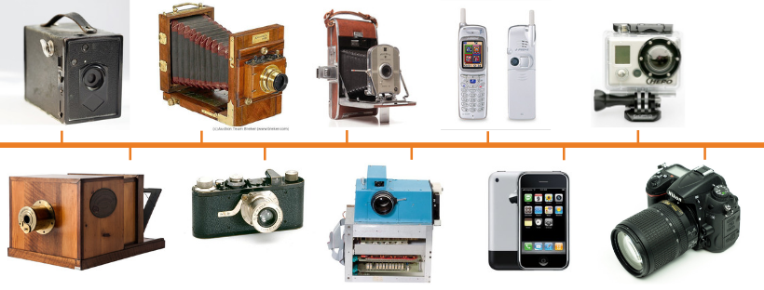
Evolution of the camera
1900 – The Reise Camera
1947 – Polaroid Model 95
Kyocera Visual Phone VP-210 - 1999
2008 – GoPro HD HERO
1839
1925 – The Leica I
1975
2007 – Apple iPhone
Image source: https://www.precisioncamerarepairs.com/blog/the-evolution-of-the-camera

Slide 9
Nowadays…
~ 1.436.300.000.000 ( > 1.4 trillion) photos will be taken in 2020 (https://focus.mylio.com/tech-today/how-many-photos-will-be-taken-in-2020 )
If you were to take all these pictures alone, and you took one pic per second = 45.544 years
As of May 2019, > 500 hours of video are uploaded to YouTube every minute! (https://www.statista.com/statistics/259477/hours-of-video-uploaded-to-youtube-every-minute/)
an estimate of 770 million surveillance cameras installed around the world today

Slide 10
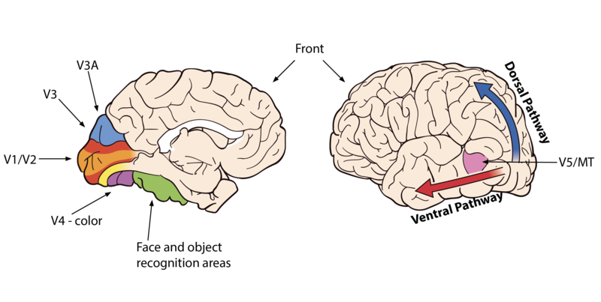
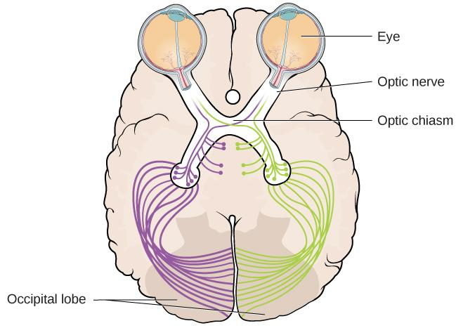
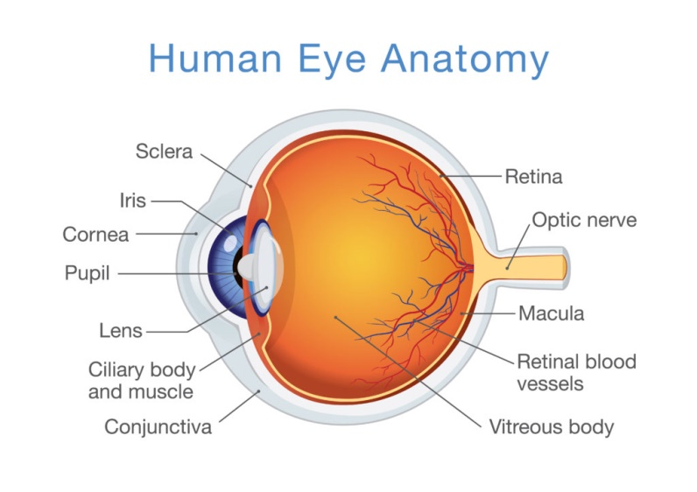
Visual cortex
Ventral pathway: “what” pathway (temporal)
Dorsal pathway: “where/how” pathway (parietal)
https://courses.lumenlearning.com/wmopen-psychology/chapter/outcome-vision/

Slide 11
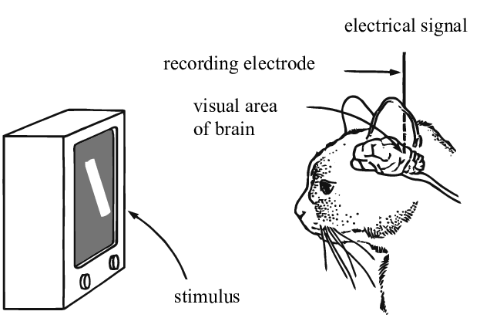
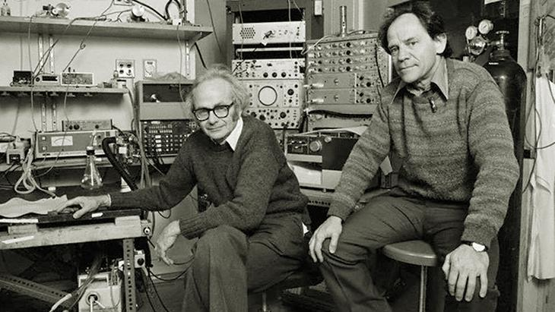
Understanding the visual cortex
Nobel Prize for Physiology or Medicine in 1981:
David Hubel and Torsten Wiesel
Simple cells:
orientation, position
Complex cells:
orientation, motion, direction
“Hypercomplex” cells:
orientation, motion, direction, length
Hubel and Wiesel, 1959
https://www.youtube.com/watch?v=IOHayh06LJ4&ab_channel=PaulLester
Image source: https://www.researchgate.net/publication/335707980_Understanding_Neural_Networks_via_Feature_Visualization_A_Survey

Slide 12
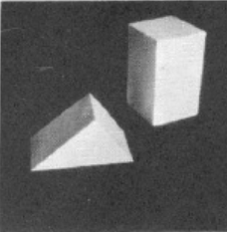
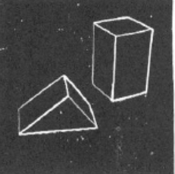
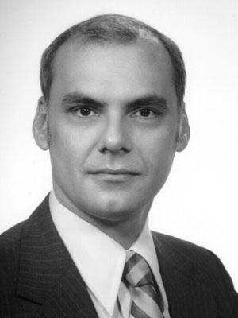
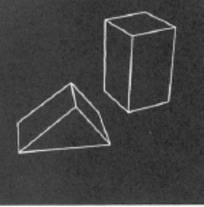
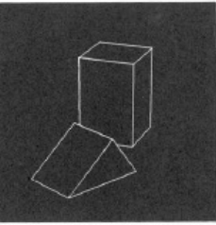
Larry Roberts
1963
First PhD thesis in the field of Computer Vision: “Machine Perception of Three Dimensional Solids”, Larry Roberts, 1963, MIT Press
extract 3D information about solid objects from 2D photographs of line drawings

Slide 13
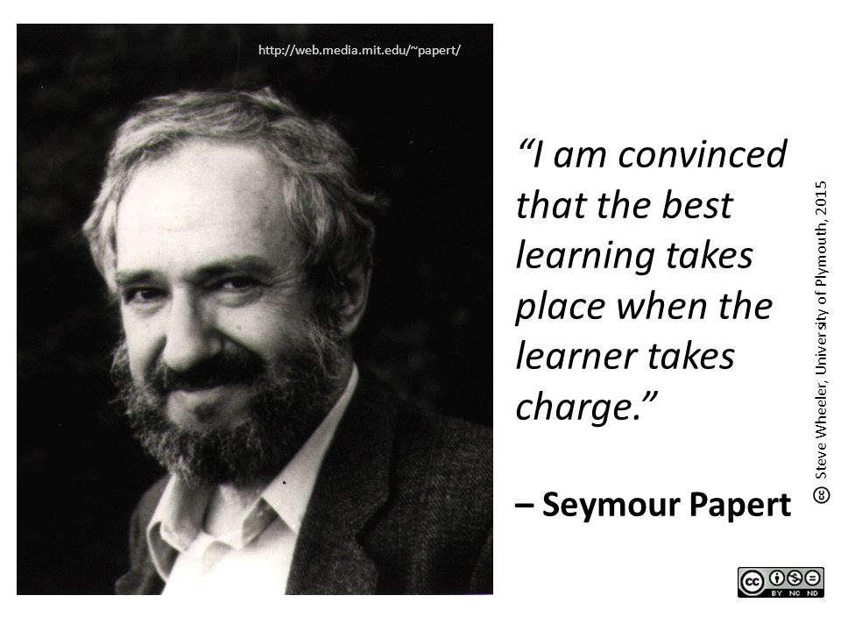
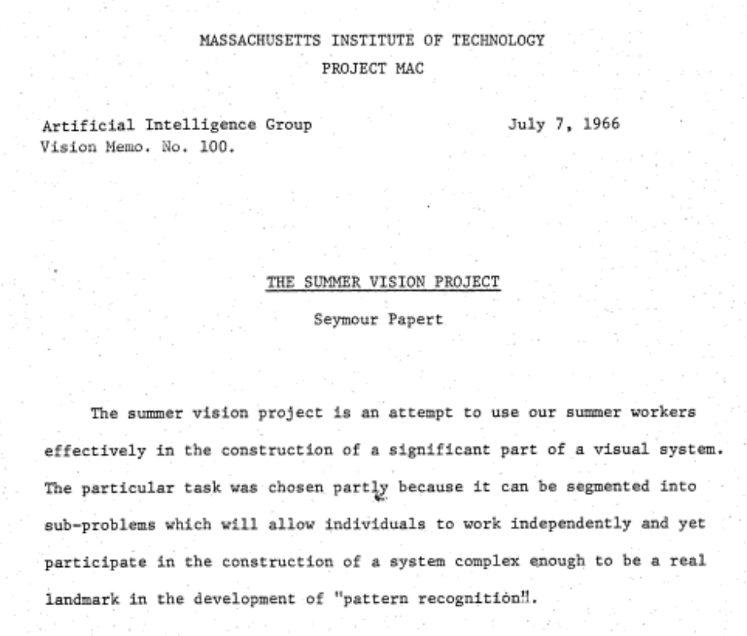
The Summer Vision Project
1966
The primary goal of the project is to construct a system of programs which will divide a vidisector picture into regions such as likely objects, likely background areas and chaos. We shall call this part of its operation FIGURE-GROUND analysis. It will be impossible to do this without considerable analysis of shape and surface properties, so FIGURE-GROUND analysis is really inseparable in practice from the second goal which is REGION DESCRIPTION. The final goal is OBJECT IDENTIFICATION which will actually name objects by matching them with a vocabulary of known objects.

Slide 14
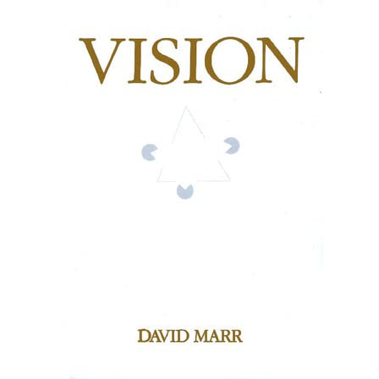
David Maar
1981
Scene
Image
Pixel intensities
Primal sketch
Edges, blobs, curves boundaries
2.5 Surface Map
2.5D Symbolic map
Depth image, surface orientations
Relational Structure
Object centred coordinate system (surface and geometrical primitives)
Recognition description

Slide 15
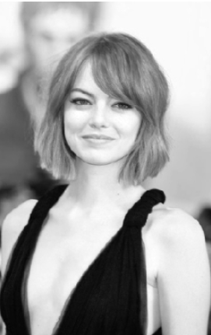
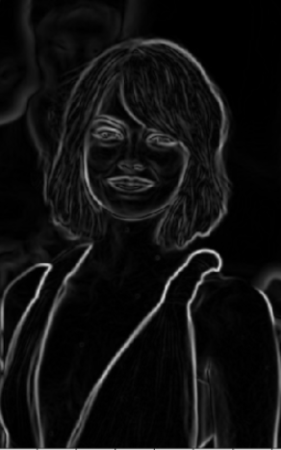
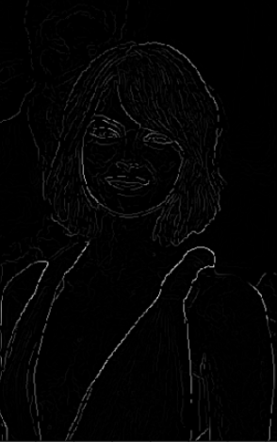
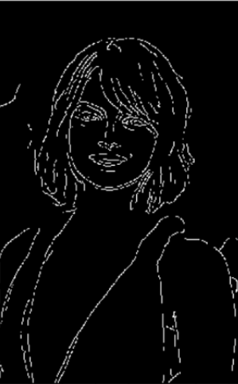
Canny edge detector
1986
Images from https://towardsdatascience.com/canny-edge-detection-step-by-step-in-python-computer-vision-b49c3a2d8123

Slide 16
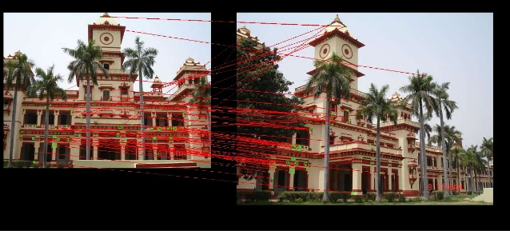
Scale Invariant Feature Transform David G. Lowe
1999
Local image features invariant to image scaling, translation, and rotation, and partially invariant to illumination changes and affine or 3D projection

Slide 17
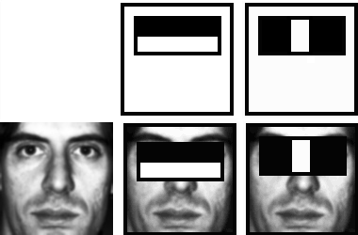
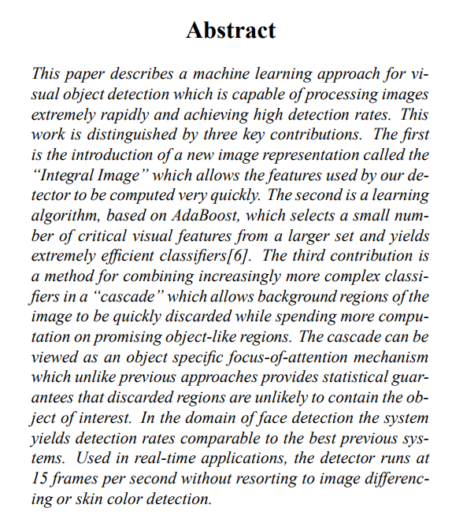
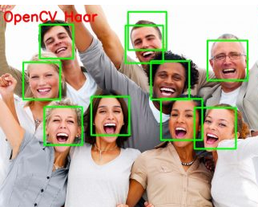
Rapid object detection using a boosted cascade of simple features Paul Viola and Michael Jones
2001

Slide 18
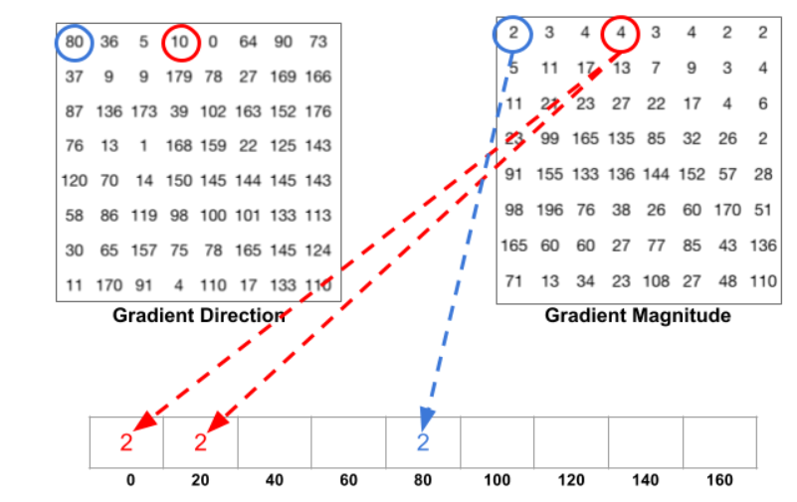
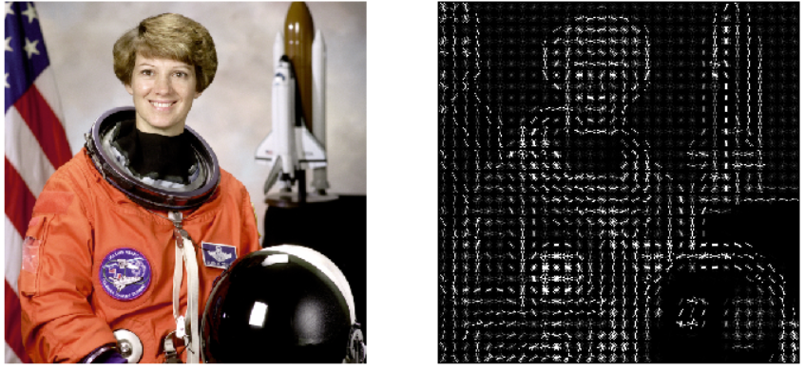
Histogram of Oriented Gradients Navneet Dalal and Bill Triggs
2005
Image source: https://iq.opengenus.org/object-detection-with-histogram-of-oriented-gradients-hog/

Slide 19
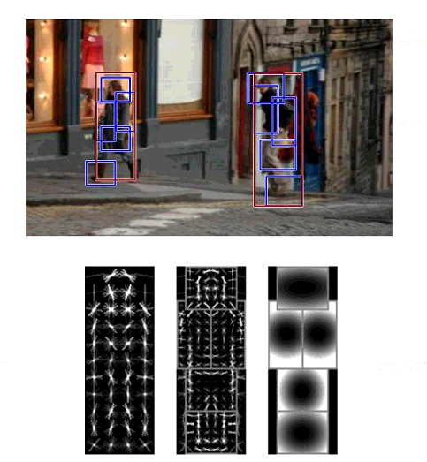
Deformable part models P. Felzenszwalb,R. Girshick, D. McAllester, D. Ramanan
2009

Slide 20
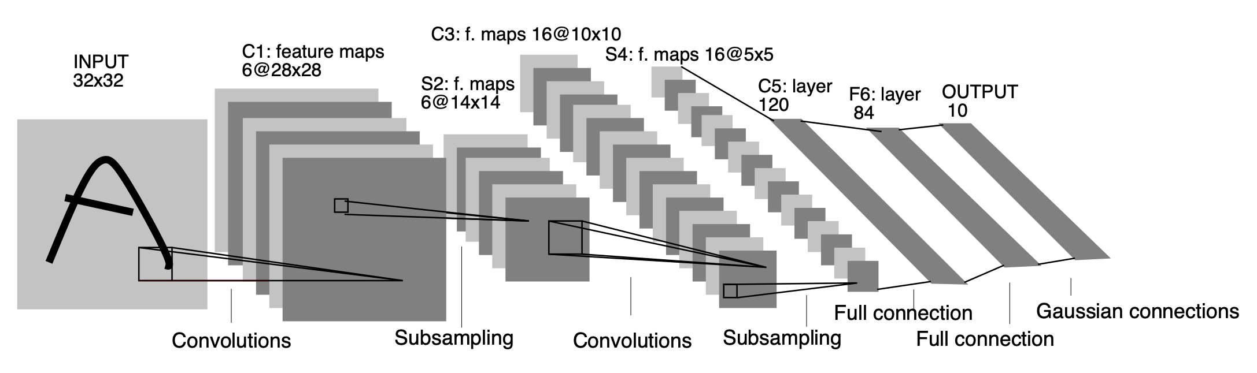
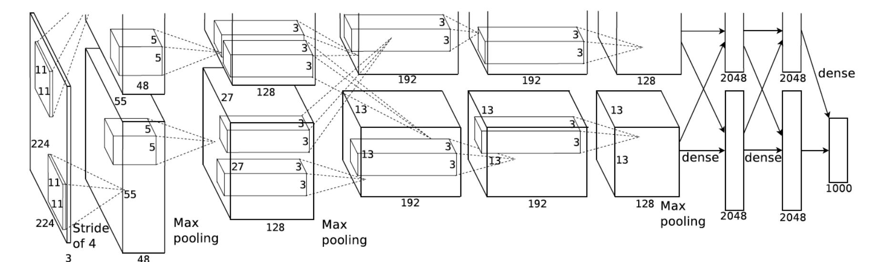
2012
LeNet (1998)
AlexNet (2012)

Slide 21

Visual transformers
2021
https://arxiv.org/abs/2010.11929

Slide 22

Data

Slide 23

Pascal VOC
2007
9,963 images containing 24,640 object split into 20 classes:
airplane, bicycle, boat, bottle, bus, car, cat, chair, cow, dining table, dog, horse, motorbike, person, potted plant, sheep, train, TV

Slide 24


ImageNet
2010
> 14 million images organized into over 20,000 categories
organized according to the WordNet hierarchy (nouns), in which each node of the hierarchy is depicted by hundreds and thousands of images

Slide 25


JFT
2017
internal dataset used by Google to train image classification algorithms
the dataset has 300M images and 375M labels (multiple labels per image, on average each image has 1.26 labels)
noisy labels: no human processing is involved
labeled using an algorithm that uses complex mixture of raw web signals, connections between webpages and user feedback
https://arxiv.org/pdf/1707.02968v2.pdf

Slide 26

Computer vision - Where are we now?
human
Image source: https://towardsdatascience.com/review-senet-squeeze-and-excitation-network-winner-of-ilsvrc-2017-image-classification-a887b98b2883

Slide 27

ImageNet accuracy

Slide 28




Computer vision applications I
Penguin
Penguin
Classification
Object Detection
Semantic segmentation
Instance segmentation

Slide 29



Computer vision applications II
Image captioning
Style transfer
Action recognition

Slide 30




Computer vision applications III
Image generation
https://thispersondoesnotexist.com/
https://edition.cnn.com/2020/02/28/tech/fake-twitter-candidate-2020/index.html
https://thesecatsdonotexist.com/

Slide 31


Computer vision applications IV
Image translation
Talking head models

Slide 32



Computer vision applications V
An astronaut riding a horse in a photorealistic style
A painting of a fox sitting in a field at sunrise in the style of Claude Monet
Teddy bears working on new AI research on the moon in the 1980s

Slide 33

Computer vision applications VI
Segment anything
https://segment-anything.com/demo
Grounding DINO

Slide 34



Computer vision surpassed human vision
Captcha recognition
Face recognition
Object recognition

Slide 35

“We should all be playing games and let AI do all the work, instead AI plays games and we do all the work”
Andrej Karpathy

Slide 36

Computer vision vs. human vision
Example from Andrej Karpathy’s blog: http://karpathy.github.io/2012/10/22/state-of-computer-vision/

Slide 37
Dataset & model zoos
Now
Typically you start with a model architecture that someone else has published.
Datasets:
https://huggingface.co/datasets (over 7000 datasets)
https://www.kaggle.com/datasets (over 200k datasets)
Models:
https://paperswithcode.com/
https://huggingface.co/models
https://pytorch.org/vision/0.8/models.html , https://pytorch.org/serve/model_zoo.html

Slide 38
Stanford AI index 2023 Top 10 takeaways
Industry races ahead of academia. - state-of-the-art AI systems increasingly requires large amounts of data, computer power, and money
Performance saturation on traditional benchmarks.
AI is both helping and harming the environment.
- BLOOM’s training run emitted 25 times more carbon than a single air traveller on a one-way trip from New York to San Francisco, but AI systems can be used to optimize energy usage.
The world’s best new scientist … AI? - aid hydrogen fusion, improve the efficiency of matrix manipulation, and generate new antibodies
The number of incidents concerning the misuse of AI is rapidly rising.
- the number of AI incidents and controversies has increased 26 times since 2012
https://aiindex.stanford.edu/wp-content/uploads/2023/04/HAI_AI-Index-Report_2023.pdf

Slide 39
Stanford AI index 2023 Top 10 takeaways
The demand for AI-related professional skills is increasing across virtually every American industrial sector. - the number of AIrelated job postings has increased on average from 1.7% in 2021 to 1.9% in 2022
For the first time in the last decade, year-over-year private investment in AI decreased.
While the proportion of companies adopting AI has plateaued, the companies that have adopted AI continue to pull ahead.
Policymaker interest in AI is on the rise.
Chinese citizens are among those who feel the most positively about AI products and services. Americans … not so much.
- 78% of Chinese respondents agreed with the statement that products and services using AI have more benefits than drawbacks. Only 35% of the Americans agree with this.
https://aiindex.stanford.edu/wp-content/uploads/2023/04/HAI_AI-Index-Report_2023.pdf

Slide 40

Stanford AI index 2023
https://aiindex.stanford.edu/wp-content/uploads/2023/04/HAI_AI-Index-Report_2023.pdf

Slide 41

Stanford AI index 2023
It took the developers using Copilot only 71 minutes to complete their task—56% less time than the developers who did not use Copilot (161 minutes).
https://aiindex.stanford.edu/wp-content/uploads/2023/04/HAI_AI-Index-Report_2023.pdf

Slide 42


CVPR 2023

Slide 43





Start-ups developing Computer Vision
OrCAM: Wearable device, for people who are blind or visually impaired, that reads text, recognizes faces, identifies products & more
Pixee Medical has created the first computer-assisted orthopaedic surgery solution using augmented reality to support total knee arthroplasty.
Ceres Imaging combines high-resolution aerial imagery with advanced analytics to help farms, orchards, and vineyards optimize irrigation strategy and performance
Valuable property attributes combined with a simple API allow investors and insurers to better select properties, evaluate risk, and streamline underwriting processes.
" Out-of-stocks" detection - FocalSystems
https://www.forbes.com/sites/robtoews/2021/02/28/a-wave-of-billion-dollar-computer-vision-startups-is-coming/?sh=21ce139b3f4c

Slide 44
Lecture
Part 1: Fundamentals. Artificial Neural Networks
Multi layer perceptron
Optimization. Loss functions
Neural Networks
Part 2: Convolutional neural networks, visual transformers, graph convolutional neural networks
Convolutions. Convolutional layers. Pooling layers.
Attention mechanisms
Transformers. Visual transformers. Foundation models.
Graph convolutional neural networks
Part 3: Applications and case studies
Object detection
Segmentation. Instance segmentation
Multimodal learning
Part 4: Ethics of Artificial Intelligence

Slide 45
Laboratories
Introduction to python, numpy.
Pytorch fundamentals. Implement a softmax classifier. Evaluating a model.
Convolutional neural networks. Fine tuning. Transfer learning. Hyperparameter tuning.
Semantic segmentation. Evaluating a semantic segmentation model.
Transformer.
Experiment management. Deploying a model.
Laboratories presentation

Slide 46
Grading
Written examination: 50%
Laboratories: 50 % (some sort of oral exam at the end of the semeter)
The final grade (average between written exam and project) should be at least 5

Slide 47
Recommended resources (1)
Mathematics for Machine Learning, Marc Peter Deisenroth, A. Aldo Faisal Cheng Soon Ong
https://mml-book.github.io/book/mml-book.pdf
Goodfellow, Ian, Yoshua Bengio, and Aaron Courville. Deep learning. MIT press, 2016.
http://www.deeplearningbook.org/
CS231n lecture, Stanford - https://cs231n.github.io/ (lecture notes)

Slide 48
Recommended resources (2)
deeplearning.ai
https://www.deeplearning.ai/ (Machine Learning Specialization, Deep Learning Specialization – courses also available on youtube)
Andrew Karpathy – Neural Networks – Zero to Hero
https://www.youtube.com/@AndrejKarpathy
Full Stack Deep Learning
https://fullstackdeeplearning.com/
Weights and biases free courses
https://www.wandb.courses/pages/w-b-courses

Slide 49
Research articles
How to read a research paper (Andrew Ng):
https://forums.fast.ai/t/how-to-read-research-papers-andrew-ng/66892
Technical writing (Zachary Lipton): https://www.approximatelycorrect.com/2018/01/29/heuristics-technical-scientific-writing-machine-learning-perspective/

Slide 50

I hope you’ll enjoy this course
Image generated with DALL-E

Slide 51


Image generated with DALL-E: Teacher saying thank you
Image generated with DALL-E: Happy students learning about AI

